Slide 1

HCI - Assignment n.2
Design and prototyping of an application using a human-centered approach
Deliverable n. 1: Requirement Analysis
Project Title: Online Shopping Agent an application for international online shopping and shipping
Group: Diogo Fernandes 89221, Martim Neves 88904 & Pedro Alves 88861
Lab Class: P1
HCI 2019-2020

Slide 2
Introduction
Online Shopping Agent
Brief contextualization / motivation. Why this project? :
Sometimes we want to buy certain products that only exist in foreign countries. And even if we find these products in online stores, many of them may not ship internationally. That is the reason we decided to make an online shopping agent.
Relation to other courses? (e.g. Data Bases, Project…)
We will need a data base to manage the warehouses, purchase orders and an app for the client interaction.
Personal Interest? Elaborate:
Two members of the group use this service.
HCI 2019-2020
2

Slide 3
Project Objectives
Online Shopping Agent
Create an application where a client can buy any product in any part of the world and have it delivered to its house.
Make the application as simple and intuitive as possible.
Create a comfortable solution for every person that shops online.
Have a product delivered to someone’s house even though the store does not ship to that country.
Create a tab for the user to see its purchase history, as well as its current orders, storage items and items shipped.
HCI 2019-2020
3

Slide 4

Personas
Online Shopping Agent
Manuel Silva, 73 years old, retired. While he was in the active, he was on the military, a very exhausting job. Therefore, he decided to enjoy his retirement by doing gardening. He recently discovered a website that sells much cheaper fertilizer for his plants. However, that website does not ship to Portugal. What Manuel needs is an Online Shopping Agent.
HCI 2019-2020
4

Slide 5

Personas
Online Shopping Agent
Isabel Moreira, 35 years old, decoration business owner. She is hired to remodel and redecorate houses. For that, she needs to buy certain pieces of furniture from an old shop in Italy that she likes. However, that shop does not ship to Portugal and, for that reason, Isabel needs an Online Shopping Agent.
HCI 2019-2020
5

Slide 6
Scenarios
Online Shopping Agent
Manuel provides a gardening product link that he wants to buy.
Manuel must be able to see his purchase orders.
Isabel must be able to see what products she has stored and ready to ship.
Isabel must be able to choose which stored products she wants to send to her destination.
Isabel must be able to see her shipping orders.
HCI 2019-2020
6

Slide 7
Tasks
Online Shopping Agent
Connect to Online Shopping Agent
Enter the app, create an account and fill some information about himself.
Make a purchase order
When you are connected, you provide a link to the product you want to buy, and the agent will buy and store it after receiving the payment.
See the progress of your order, as well as having the shipment tracking number
After you placed the order, you will be able to check the status (bought, shipped, stored.) and after being shipped, you can see where it currently is by using the tracking number.
See all the products you got stored
Go to purchase history and you can see which products are stored.
Sending your products to your destination
Choose from the stored products which you want to send and then place a shipping order to the destination.
HCI 2019-2020
7

Slide 8
Requirements
Online Shopping Agent
Non-functional requirements:
The UI of the web app will be simple and intuitive for the user. So that any user with little effort can accomplish the tasks.
User will provide information about payment methods, addresses, etc, the web app will guarantee their security and privacy.
In case of any problem the app will maintain a history of the transactions, so that they can be solved
Functional Requirements:
Create an account and log in.
Make a purchase order, providing the link of the product the user wants to buy in the online agent.
See purchase and shipping orders.
See the status of the order through a tracking code.
See what items are in the warehouse and choose which ones to order.
Order them to the final destination.
HCI - 2019-2020
8

Slide 9
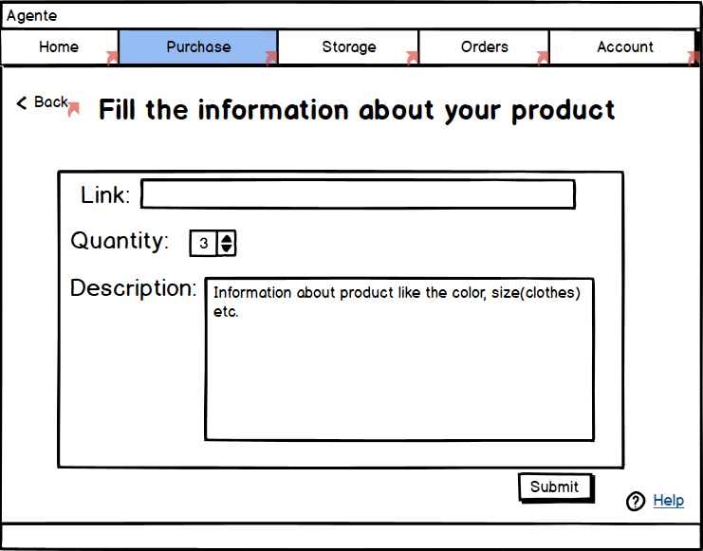
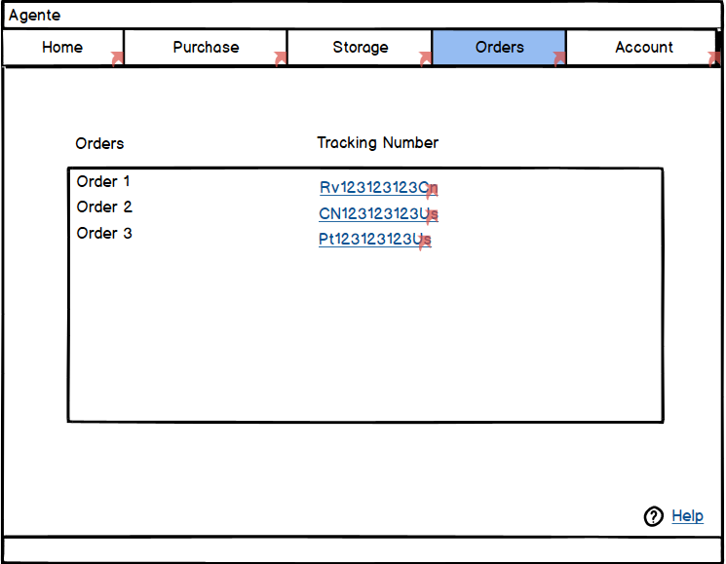
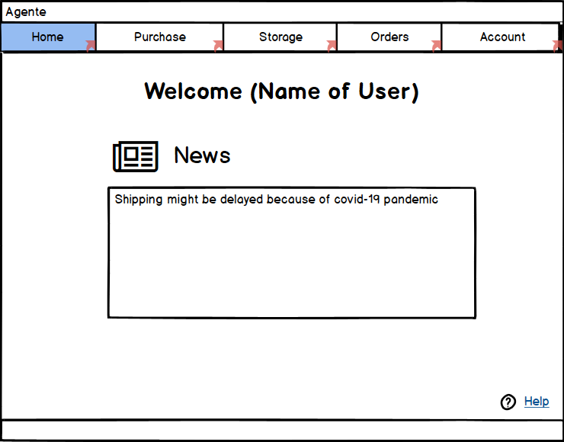
Low Fidelity Prototype
Online Shopping Agent
We developed a digital prototype using Balsamiq Wireframes.
Our prototype was developed having in mind the requirements that we defined previously, so we focused on developing all of the features possible, to make sure all of the requirements were fulfilled.
HCI 2019-2020
9

Slide 10
LFP User Evaluation
Online Shopping Agent
To test our prototype we asked five people to use it and try to perform the
tasks we set previously. We used family members from different age groups
in order to have a more differentiated and reliable feedback.
As we were expecting, the eldest were the ones with more difficulties but
still managed to perform the tasks, as the prototype is fairly easy to use and
comprehend.
Main results
After looking at the user evaluation we decided that our prototype was simple and intuitive, therefore not needing any substantial change.
END OF 1st DEVELOPMENT CYCLE!
HCI 2019-2020
10

Slide 11



Platform Used for the Functional Prototype
Online Shopping Agent
To develop our functional prototype we used the Visual
Studio IDE and the hardware used for the development was our laptops.
We used the language C# and WPF. For the database we used SQL.
As to the libraries used, we only used the System library.
Since this project was developed in parallel with the project from the Database course, it is necessary to be connected to the UA network (through a VPN, for example) in order to execute the code.
HCI 2019-2020
11

Slide 12
User Evaluation of the Functional Prototype
Online Shopping Agent
 | 1 | 2 | 3 | 4 | 5
Log In | X
Add a product to the cart and purchase it |  |  | X
Remove a product from the cart |  | X
View all stored products | X
Choose and create a shipping order |  | X
View a purchase order | X
Change account details |  | X
We used a scale from 1 to 5, in which 1 is very easy and 5 is very hard
HCI 2019-2020
12

Slide 13
User Evaluation of the Functional Prototype
Online Shopping Agent
Due to the situation we find ourselves in, the usability tests were performed on family members with different age groups, so that we were able to assess how people of different ages and experiences interact with our application and what difficulties they have when trying to perform the above tasks.
To measure the difficulty that the testers felt while performing the given tasks we use a scale from 1 to 5, 1 being very easy and 5 being very hard. As there were more than 10 participants, we took all of the answers and calculated the median to each task and that is what is represented in the table above. As we would expect, the eldest were the ones with most difficulties but still managed to accomplish most of the tasks without help, as our application was designed to be simple and intuitive.
HCI 2019-2020
13

Slide 14
Changes Made to the Functional Prototype
Online Shopping Agent
We changed the graphical appearance of the tables to make them more pleasing to look at and to make them more intuitive.
The input boxes for the user to write the price and the weight of the product didn’t have unities and it made some users confused so we added the unities to each input box.
We also added a feature that allows the user to see the combined price of all items as he is choosing the company which is going to deliver the items to his house.
END OF 2nd DEVELOPMENT CYCLE!
HCI 2019-2020
14

Slide 15
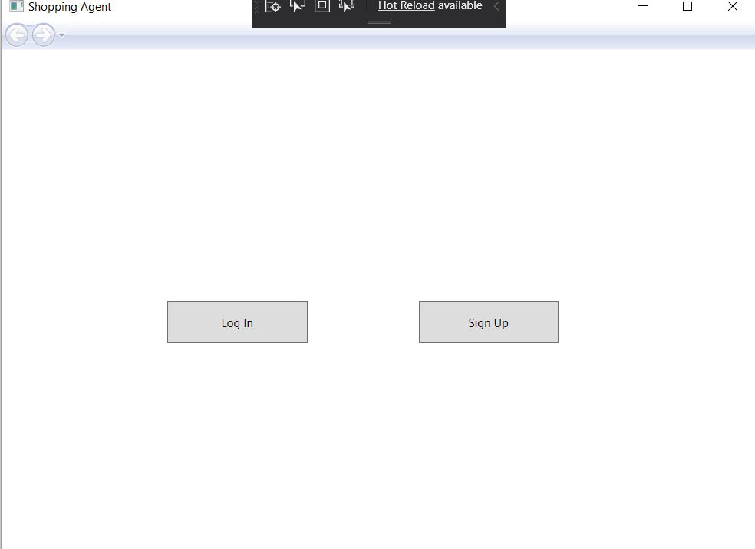
Demo
Online Shopping Agent
Not implemented:
Signup and Login page, working but not implemented graphically;
Account not working;
Login and Signup page
HCI 2019-2020
15

Slide 16
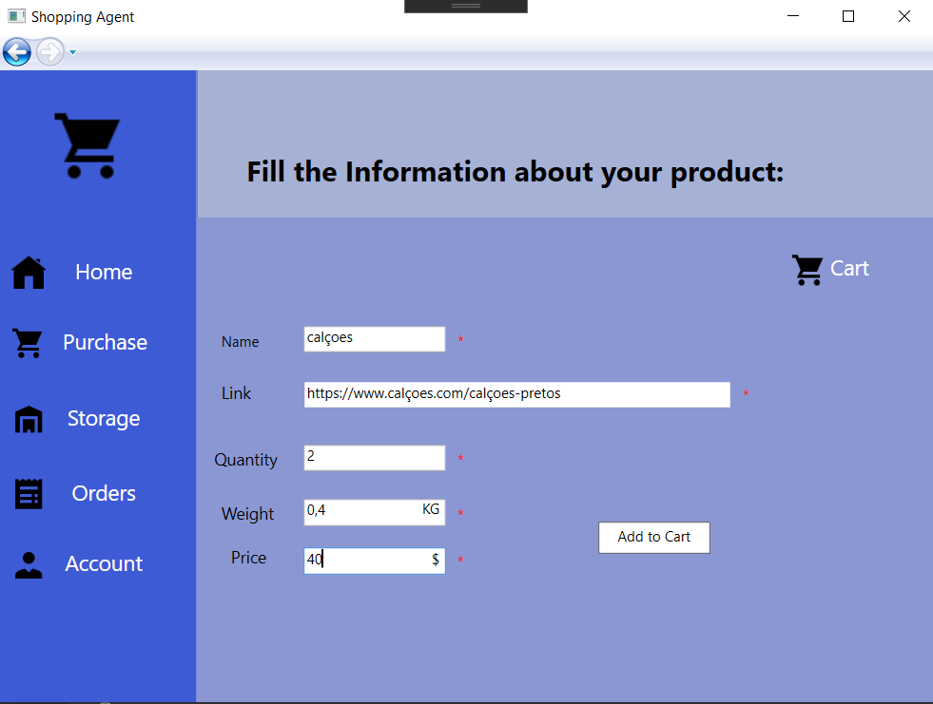
Demo
Online Shopping Agent
Purchase Page;
Shopping Cart;
Submitting Order:
Purchase Page
HCI 2019-2020
16

Slide 17
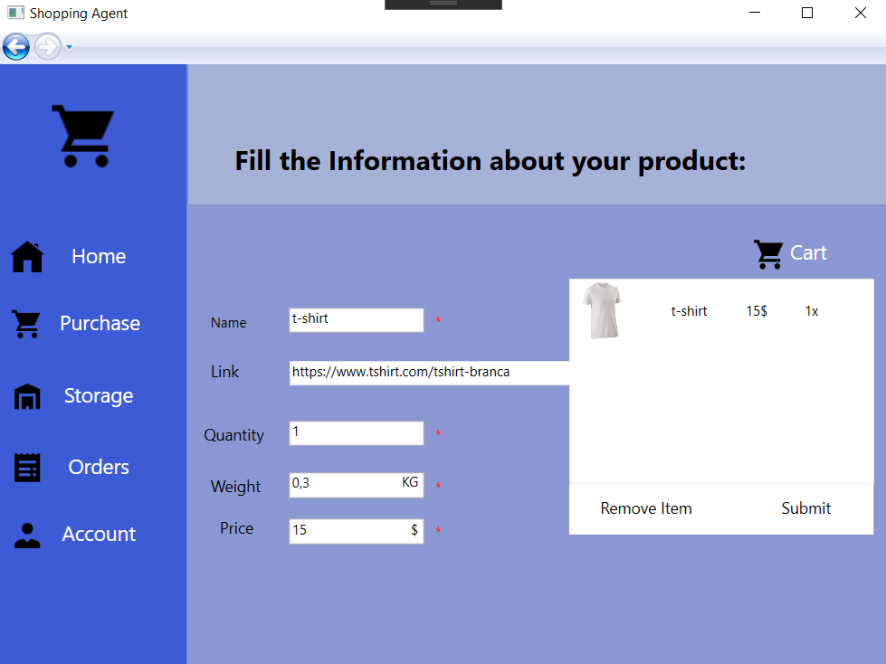
Demo
Online Shopping Agent
Purchase Page;
Shopping Cart;
Submitting Order:
Shopping Cart
HCI 2019-2020
17

Slide 18
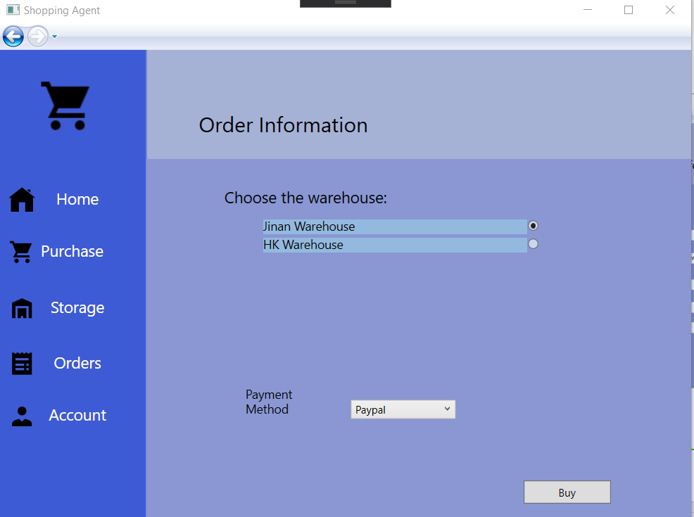
Demo
Online Shopping Agent
Purchase Page;
Shopping Cart;
Submitting Order:
Submitting Order
HCI 2019-2020
18

Slide 19
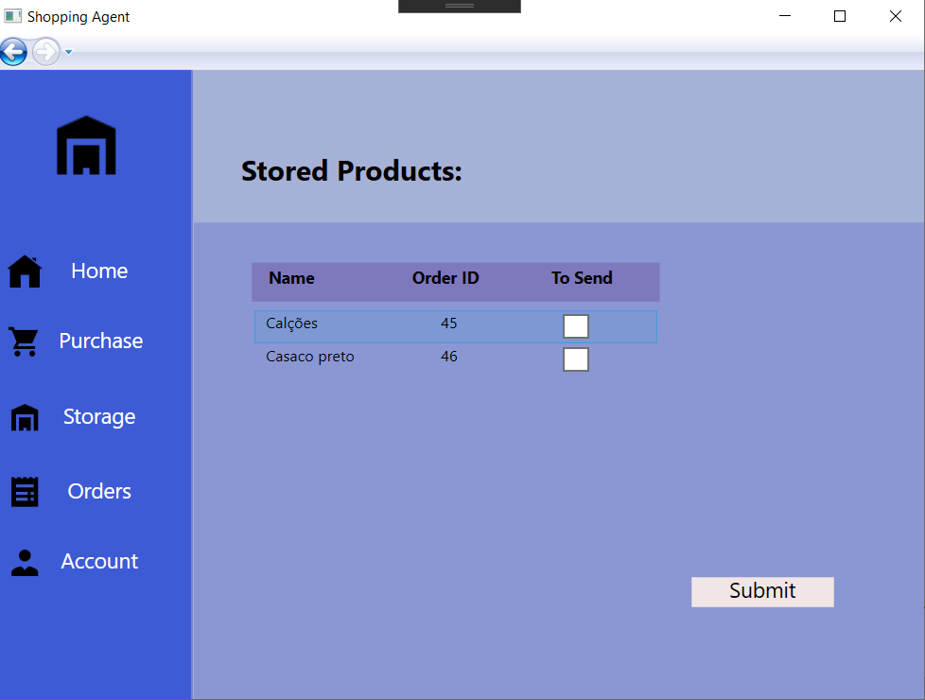
Demo
Online Shopping Agent
Storage Page
Storage Page with some stored products
HCI 2019-2020
19

Slide 20
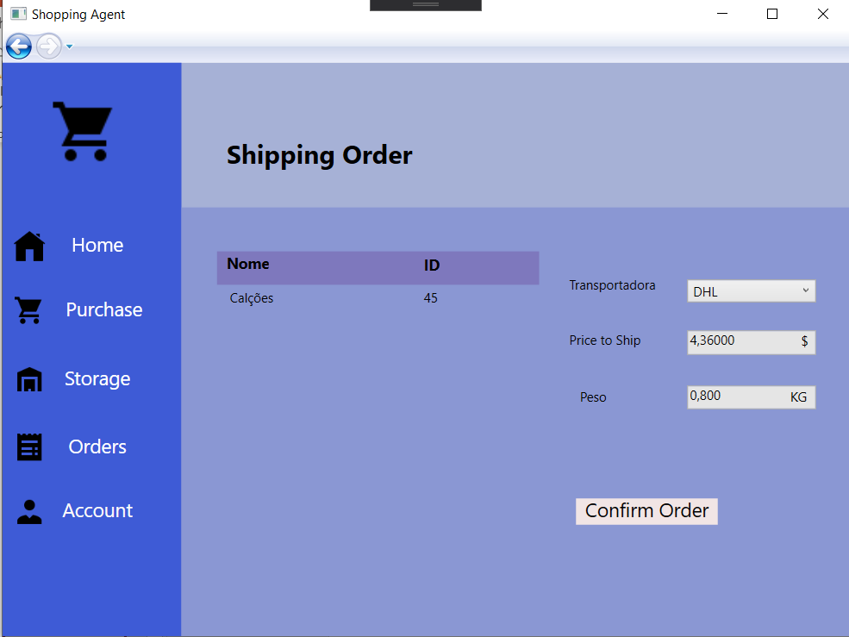
Demo
Online Shopping Agent
Shipping page
Submitting a shipping order
HCI 2019-2020
20

Slide 21
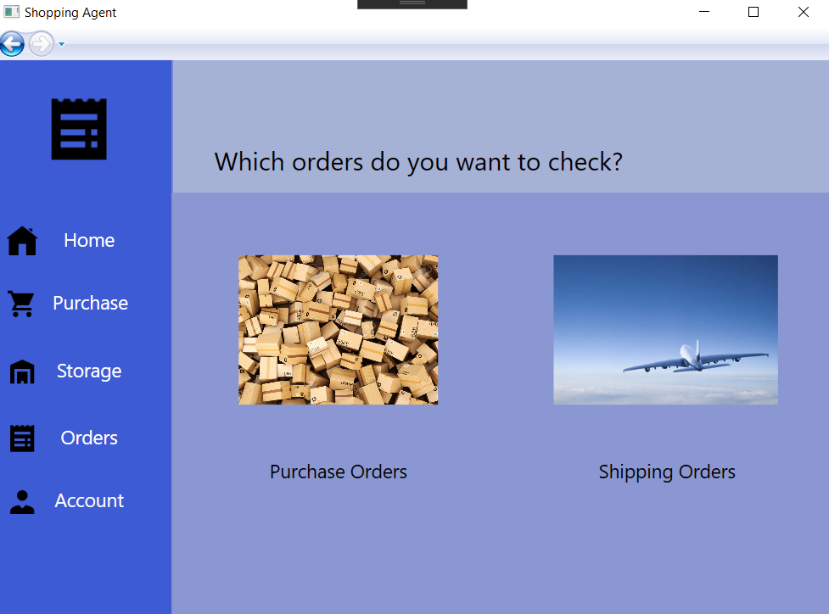
Demo
Online Shopping Agent
Orders page
Orders Page
HCI 2019-2020
21

Slide 22
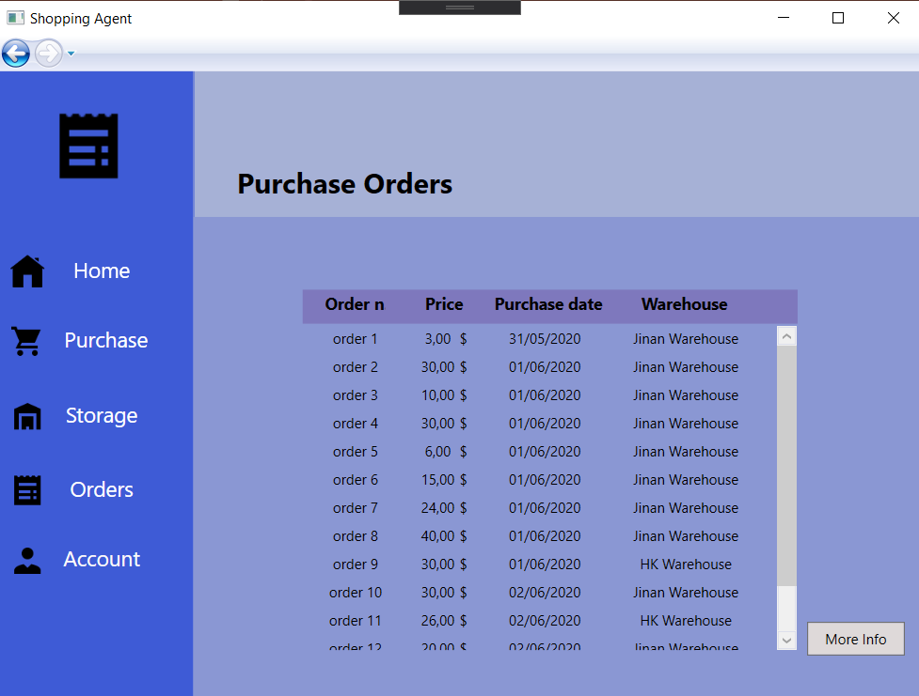
Demo
Online Shopping Agent
Purchase Orders page
All Purchase Orders made by a client
HCI 2019-2020
22

Slide 23
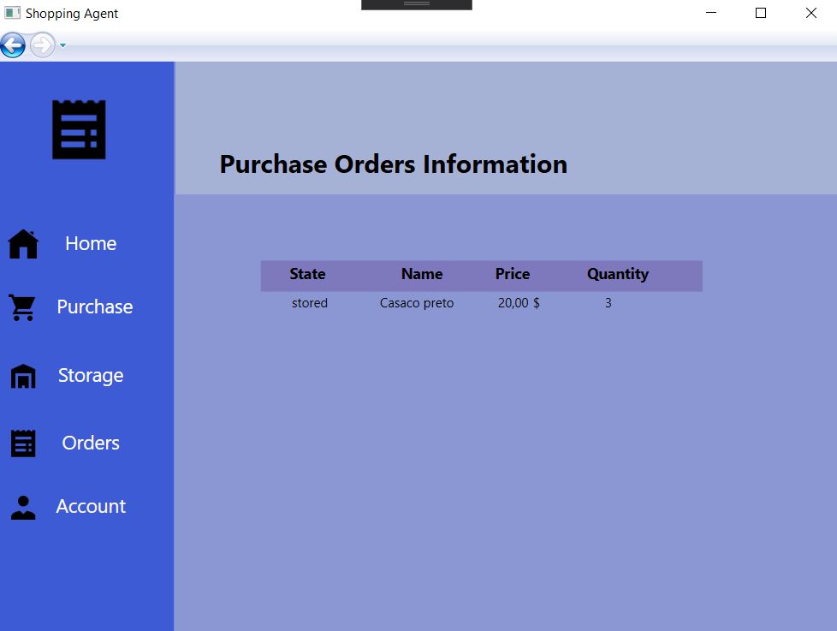
Demo
Online Shopping Agent
Purchase Orders page
More info. about an order
HCI 2019-2020
23

Slide 24
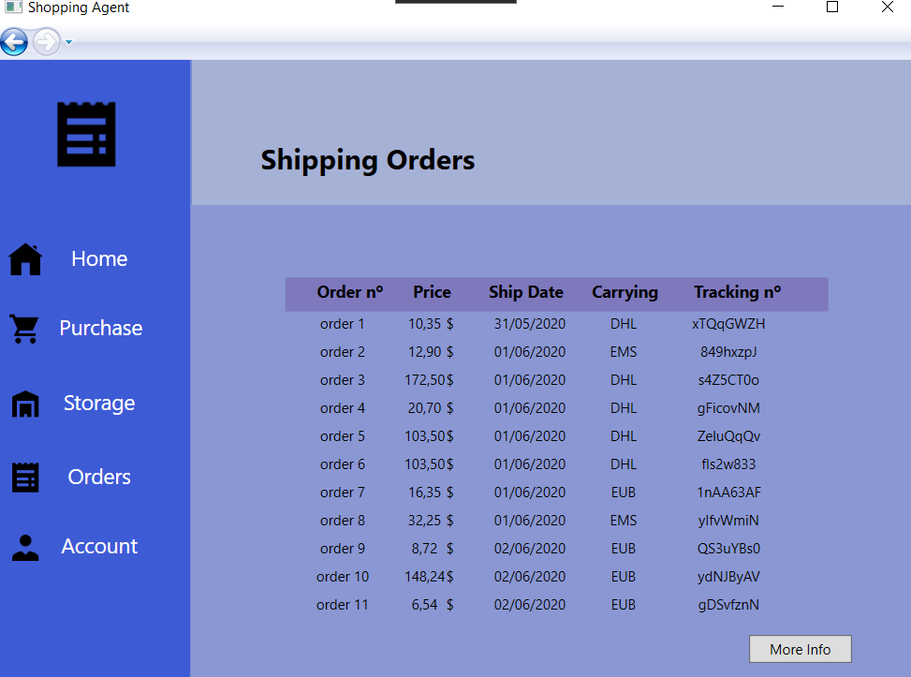
Demo
Online Shopping Agent
Shipping Orders page
Shipping orders from a client
HCI 2019-2020
24

Slide 25
Future Work
Online Shopping Agent
Develop the graphic interface of the log in page
Allow the client to edit the account details
Develop a Web App
Effort of each group member
Same effort
HCI 2019-2020
25

